Slide 1


A
Project Presentation
“INTRUSION DETECTION SYSTEM”S
Submitted in the partial fulfillment for the award of
Bachelor of Engineering
in
Computer Science and Engineering
Presented by
LAXMI MAIGUR 2GO19CS018
VAISHNAVI G S 2GO19CS037
ZEHRAKHATOON 2GO19CS041
ANUSHA G S 2GO19CS042
Under the guidance of
Dr. SHIVAPRAKASH Dept of CSE, GEC Haveri
Assistant professor
Project Seminar coordinator
Prof. D CHAUHAN Dept of CSE, GEC Haveri
Head of the department
GOVERNMENT ENGINEERING COLLEGE
HAVERI- 581110

Slide 2

CONTENTS
PROBLEM STATEMENT
INTRODUCTION
LITERATURE SURVEY
OBJECTIVES
HARDWARE/SOFTWARE DESCRIPTION
METHODOLOGY
RESULTS
BENEFITS/APPLICATION
FUTURE SCOPE
CONCLUSION
REFERENCE

Slide 3
PROBLEM STATEMENT
In earlier Many approaches have been proposed to detect cyber-attacks.
Problems such as signature-based methods, histogram-based methods volume-based methods and information theory-based methods.
The accuracy of intrusion detection is not high in traditional machine learning technology.
To overcome this problems we use deep learning.
In this model we proposed Convolutional Neural Network algorithm.

Slide 4
INTRODUCTION
Nowadays Machine Learning is play more important role in the business as well as in scientific.
Machine learning comes with many technologies like deep learning, which helps classification techniques.it helps in recommendation process easily.
In recent years, network attack detection attracts increasing interest in social networking information security as the increasing security threats.
With the inexorably profound reconciliation of the Internet and society, the Internet is changing the manner by which individuals live, study and work, yet the different security dangers that we face are turning out to be increasingly genuine.

Slide 5
An Intrusion Detection System (IDS), a huge research accomplishment in the data security field, can distinguish an attack, which could be a continuous intrusion or an interruption that has just happened.
In this project we are distinguishing whether system traffic conduct is ordinary or abnormal, or a five-classification arrangement issue, i.e., recognizing whether it is typical or any of the other four assault types: Denial of Service (DOS), User to Root (U2R), Probe (Probing) and Root to Local (R2L).
To put it plainly, the primary inspiration of interruption recognition is to improve the exactness of classifiers in adequately distinguishing the meddling conduct.

Slide 6
LITERATURE SURVEY
Sl. No. | Title | Author | Implementation | Drawbacks
1 | Machine Learning Algorithms In Context Of Intrusion Detection | Tahir Mehmood , Helmi B Md Rais | The detection of different attacks occurs in system. | Fail to detect the different attacks occurs other than the dataset.
2 | Using Incremental Learning Method For Adaptive Network Intrusion Detection | WU Yang , Xiao-Chun Yun , Le-Jun Zhang | The traditional static detecting model must relearn over all the old and new examples, even can’t relearn because of limited memory size. | Fail to get more accuracy in result.

Slide 7
Sl. No. | Title | Author | Implementation | Drawbacks
3 | Intrusion Detection Using Semi-Supervised Machine Learning | Chidananda Murthy P, AS Manjunatha | In this model they show how to predict the unlabeled traffic. | Fail to implement more set of different data and automatic preprocessing of data.
4 | Intrusion Detection System Using PCA with Random Forest Approach | Mr Subhash Waskle, Mr Lokesh Parashar, Mr Upendra Singh | In this module they organise the dataset by reducing the dimensionality of the dataset and the random forest will help in classification | Fail to extract features from samples.

Slide 8
OBJECTIVES
To achieve an network intrusion detection system based on convolutional neural networks.
To achieve an intrusion detection system which is designed to detect almost all types of malicious network attacks.
To achieve a system which combines the convolution of pooling operations to better extract the feature relationship between the data.
To achieve a more advanced technology that automatically extracts features from samples and get high accuracy of detection.

Slide 9
HARDWARE/SOFTWARE REQUIREMENTS
Hardware Requirements
Processor : Intel i5 3.30 GHz.
Hard Disk: 40 GB (min)
Ram : 8GB
Software Requirements
Operating system : Windows 10
Coding Language: Python.
Framework: Flask

Slide 10
METHODOLOGY

Slide 11
Continue….
It shows network intrusion detection framework based on convolutional neural network algorithm
The convolutional neural network structure is composed of input, convolutional layer, pooled layer, fully connected layer and output layer.
The convolutional neural networks with different structures have different numbers of convolution and pooling layers. The framework mainly consists of three steps:

Slide 12
Continue…..
Data preprocessing: It mainly converts symbolic data into numerical data, and then normalizes the data.
Training and Feature Extraction: Use CNN model for data training and feature extraction.
Classification: Use the softmax classifier to classify and get the classification results.

Slide 13
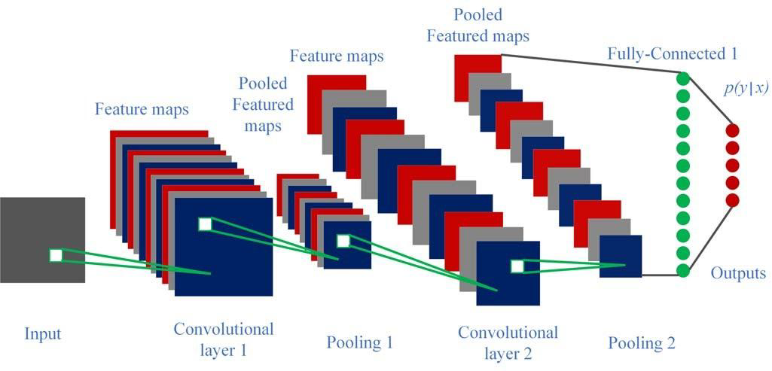

Slide 14
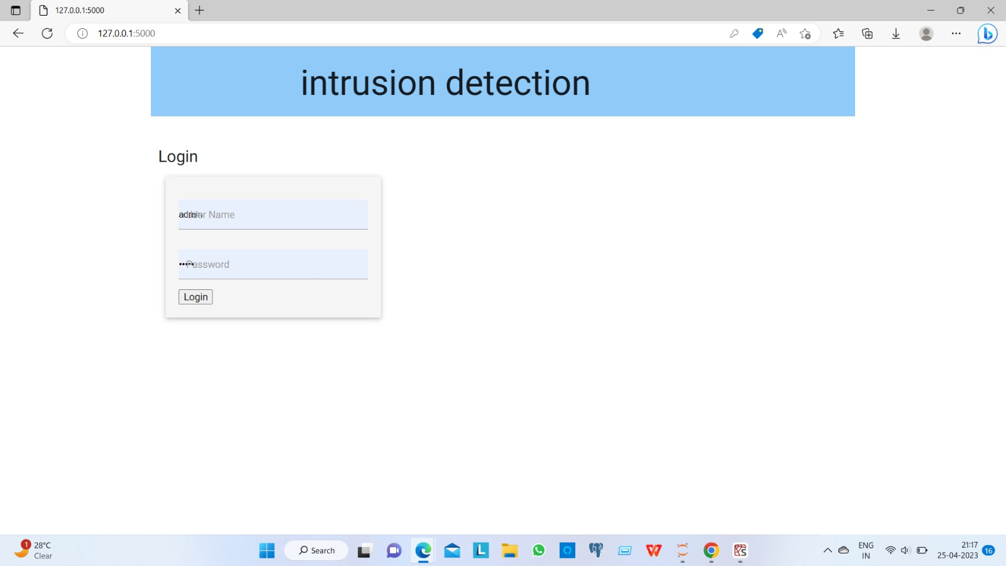
RESULTS
Login page

Slide 15

RESULTS
First page

Slide 16
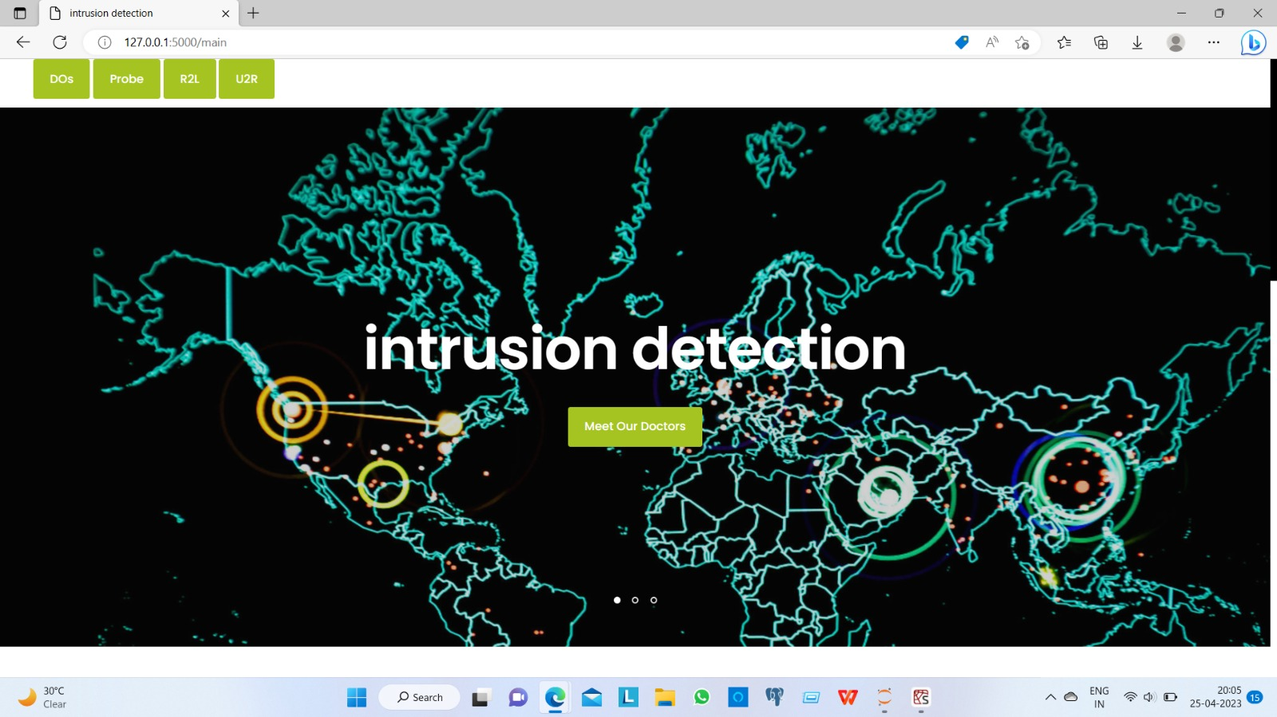
RESULTS

Slide 17
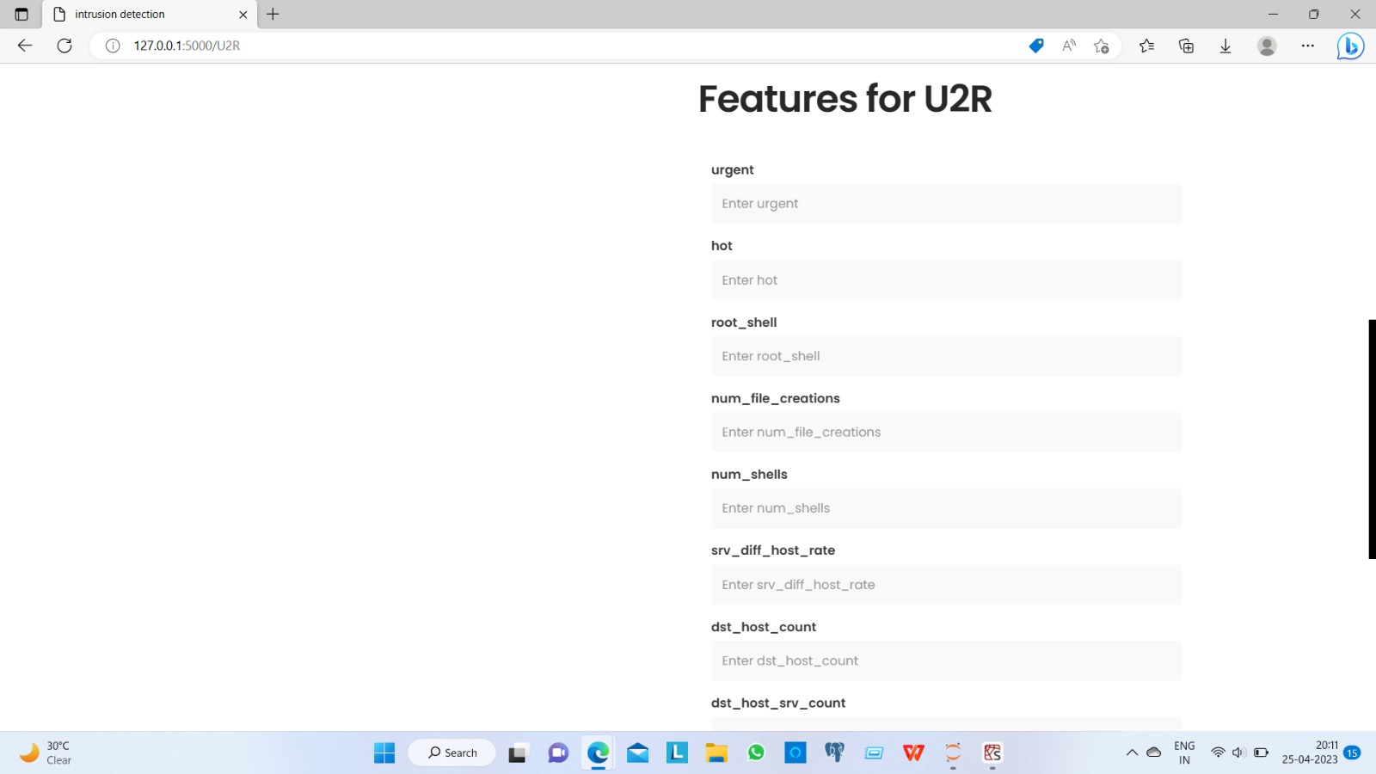
RESULTS

Slide 18
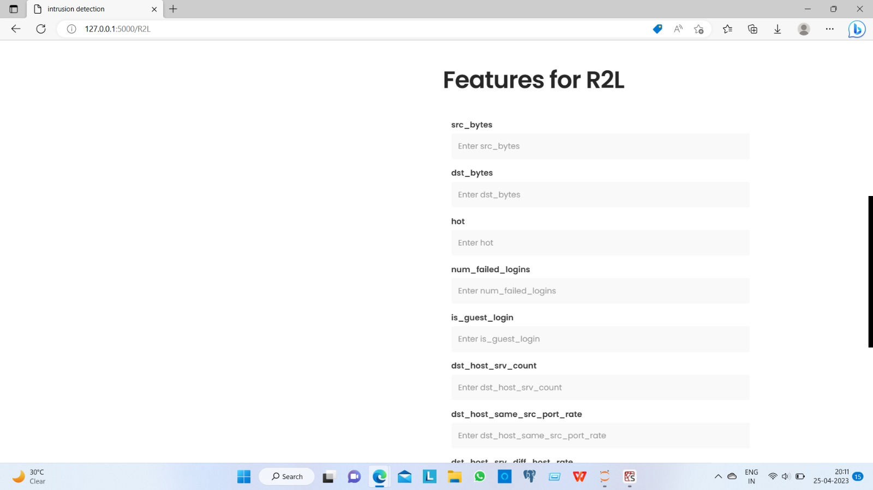
RESULTS

Slide 19
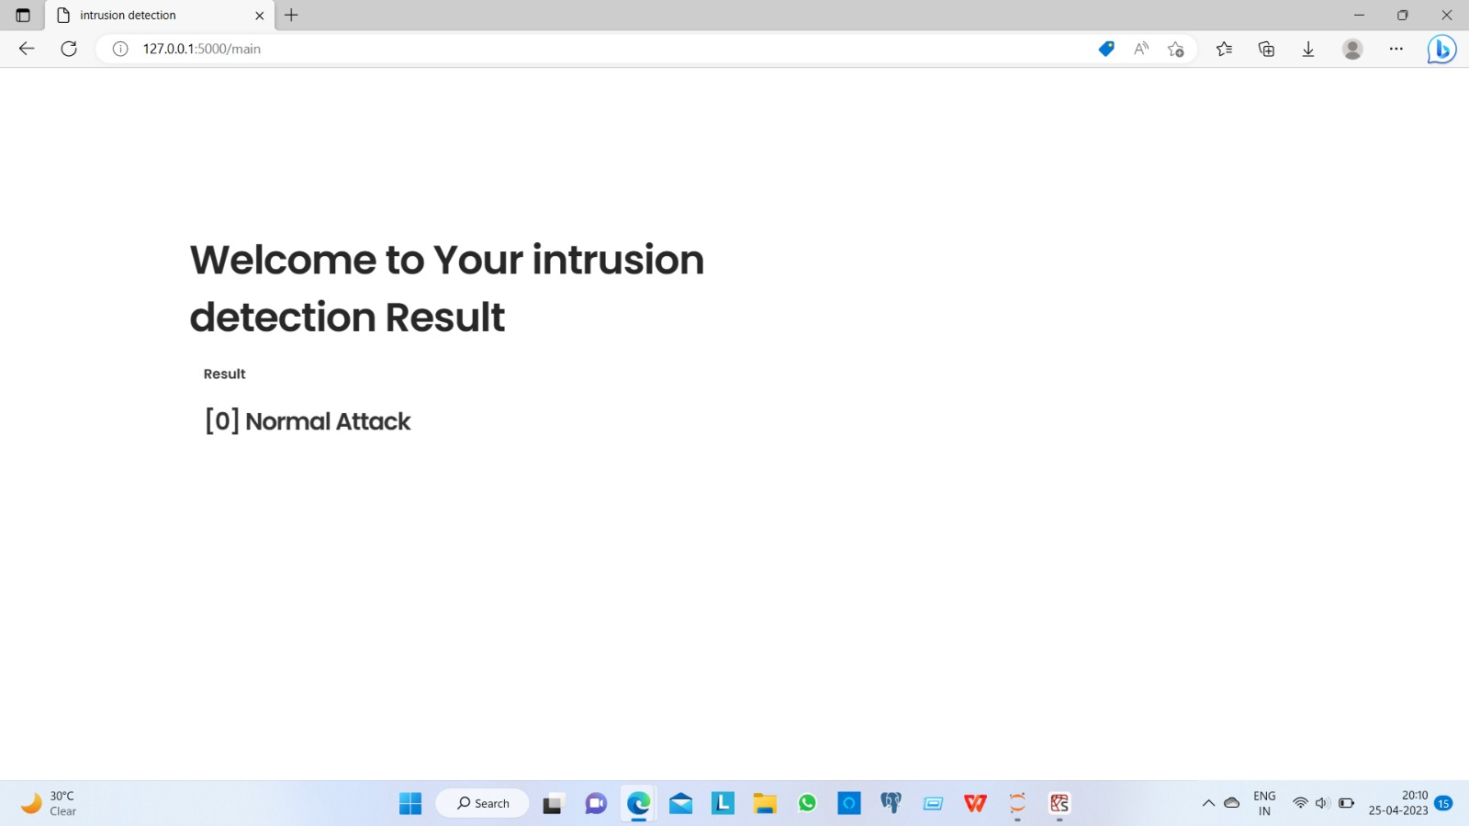
RESULTS
Output

Slide 20
BENEFITS/APPLICATION
Intrusion Detection System (IDS) acts as a defensive tool to detect the security attacks on the web.
A network-based intrusion detection system (NIDS) detects malicious traffic on a network.
It can be used to help analyze the quantity and types of attacks.
Organizations can use this information to change their security systems or implement more effective controls.
An intrusion detection system can also help companies identify bugs or problems with their network device configurations.

Slide 21
FUTURE SCOPE
Here we detecting all the attacks .
This one is useful until human uses the system.
Advances in data correlation and alert correlation methods.
This system can also be extended using for business security.
Better algorithms can be developed to increase efficiency and quality of results.

Slide 22
CONCLUSION
Intrusion detection system are essential for today security corporate world and for network users. The technique of anomaly detection and misuse detection are challenges to overcome. In this project train machine based on algorithms and features of various datasets. The experimental results using the dataset demonstrates the effectiveness of approaches like attacks are DoS,Probs U2R,L2R attacks of detection precision and detection stability.

Slide 23
REFERENCES
[1] Wen-Hui Lin, Hsiao-Chung Lin, Ping Wang, Bao-Hua Wu, Jeng-Ying Tsai, “Using Convolutional Neural Networks to Network Intrusion Detection for Cyber Threats”, IEEE ICASI 2018.
[2] Sheraz Naseer, and Yasir Saleem, “Enhanced Network Intrusion Detection using Deep Convolutional Neural Networks”, VOL. 12, NO. 10, Oct. 2018
[3]r. u. khan, x. zhang et r. kumar, “Analysis of resnet and googlenet models for malware detection, Journal of Computer Virology and Hacking Techniques,”AUG 2018.
[4] r. u. khan, x. zhang, r. kumar et e. o. aboagye, “Evaluating the performance of resnet model based on image recognition,” in Proceedings of the 2018 International Conference on Computing and Artificial Intelligence, ICCAI 2018, (NEW YORK, NY, USA), P. 86–90, ACM, 2018.
[5] r. kumar, z. xiaosong, r. u. khan, i. ahad et j. kumar, “Malicious code detection based on image processing using deep learning,” in Proceedings of the 2018 International Conference on Computing and Artificial Intelligence, ICCAI 2018, (NEW YORK, NY, USA), P. 81–85, ACM, 2018.
[6] m. g. raman, n. somu, k. kirthivasan et v. s. sriram, “A hypergraph and arithmetic residue-based probabilistic neural network for classification in intrusion detection systems”, Neural Networks, VOL. 92, P. 89–97, 2017.
[7] s. venticinque et a. amato, “Smart sensor and big data security and resilience, in Security and Resilience in Intelligent Data- Centric Systems and Communication Networks,” P. 123–141, ELSEVIER, 2018.
[8] s. m. h. bamakan, h. wang et y. shi, “Ramp loss k- support vector classification-regression; a robust and sparse multi-class approach to the intrusion detection problem”, Knowledge-Based Systems, VOL. 126, P. 113–126, 2017.

Slide 24
THANK YOU

